Slide 1
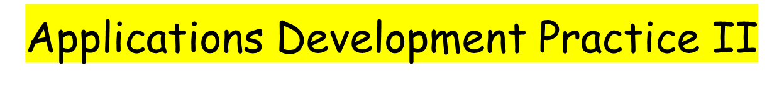

21 May 2021
Radford Burger

Slide 2

Polymorphism - instanceof
File-handling
Exception-handling

Slide 3

The instanceof keyword checks whether an object is an instance of a specific class or an interface.
The return value is either true or false
Let’s look at our Employee application and the Payable interface

Slide 4
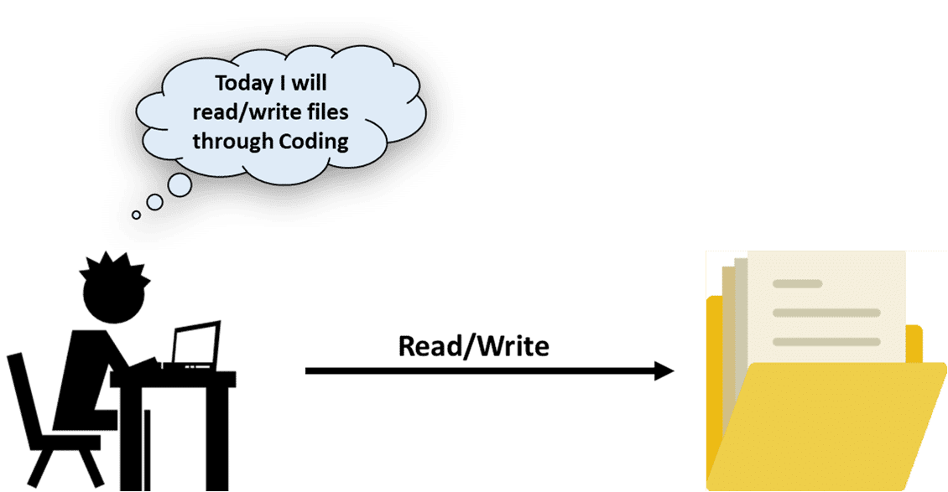
File-handling
Exception-handling

Slide 5
File-handling (sequential text files)
  Simple text files, readable by humans.
  Java has no format or structure for these files.
  Values are written/stored as separate and independent.
  Programmer imposes a record structure with newline character after each set of related values.

Slide 6
Creating and writing to a sequential text file
  WordPad example
  Various Java classes can be used.
  We will use classes BufferedWriter and FileWriter
  These classes are defined in the package….?
  Let’s look at a Java coded example

Slide 7
Exception-handling
example demonstrating Exception being thrown but not handled:
class DivideByZeroNoExceptionHandling

Slide 8
Exception-handling
A try block begins with the keyword try and is followed by a block of code enclosed in curly braces.
We use the term “try block" to refer to the block of code following the try keyword, as well as the keyword itself.
A catch block begins with the keyword catch and is followed by a parameter in parentheses (called the exception parameter) and a block of code enclosed in curly braces.
We use the term "catch block" to refer to the block of code following the catch keyword, as well as the keyword itself.

Slide 9
Exception-handling
At least one catch block or a finally block must immediately follow the try block.
Each catch block specifies in parentheses an exception parameter that identifies the exception type the handler can process.
When an exception occurs in a try block, the catch block that executes is the one whose type matches the type of the exception that occurred (i.e., the type in the catch block matches the thrown exception type exactly or is a superclass of it).

Slide 10
Exception-handling
If an exception occurs in a try block, the try block terminates immediately and program control transfers to the first of the following catch blocks in which the exception parameter's type matches the type of the thrown exception.
After the exception is handled, program control does not return to the throw point because the try block has expired (which also causes any of its local variables to be lost).
After executing a catch block, this program's flow of control proceeds to the first statement after the last catch block, or…

Slide 11
Exception-handling
After executing a catch block, this program's flow of control proceeds to the first statement after the last catch block, or…
to the statements in the finally block, if one has been defined.
In fact, the statements in the finally block always execute, whether an exception occurred or not.

Slide 12
Exception-handling
Remember, a finally block is optional.
The finally block is a tool for preventing resource leaks.
When closing a file or connections or streams, place the code in a finally block to ensure the resource is always recovered.

Slide 13
Preparation for next class
We will use the BufferedReader and FileReader classes to read text from a file.
See if you can write a program to read and display the text from the txt file we created today.

Slide 14

File-handling (reading sequential text files)

